Slide 1
Financial Analytics Assignment 2 Loan Stats Analytics
Anshuman Dash

Slide 2
Problem Statement
To classify if the borrower will default the loan using borrower’s finance history. That means, given a set of new predictor variables, we need to predict the target variable as 1 -> Defaulter or 0 -> Non-Defaulter. The metric we use to choose the best model is ‘False Negative Rate’. (predictor and target variables explained later)

Slide 3
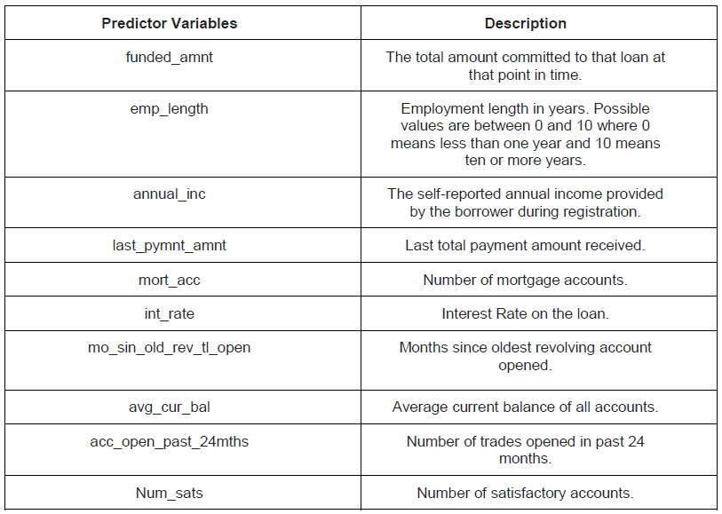
Predictor Variables
Mentioned are the features used for the model:

Slide 4
Target Variable
The target variable in our dataset is ‘loan_status’ which shows the status of the loan. It has 3 different values – ‘Charged Off’, ‘Fully Paid’ and ‘Default’.
Fully Paid: Loan has been fully repaid.
Default: Loan has not been current for 121 days or more.
Charged Off: Loan for which there is no longer a reasonable expectation of further payments.
Since our project goal is to predict whether a borrower will default the loan, we are considering only the observations where loan_status is either Fully Paid or Charged Off. We have changed Fully Paid as 0 and Charged Off as 1 where 1 indicates the borrower as a defaulter.

Slide 5
Evaluation Approach
For Loan default prediction project, False Negatives Rate is the best metric to evaluate the model. Lower the number of false negatives, better the model is. In this project, False negative is when model predicting “a borrower will not default a loan even though he will “. Our model cannot afford having higher False Negatives as it leads to negative impact on the investors and the credibility of the company. So, we evaluated our models using the number of False negatives and accuracies.

Slide 6
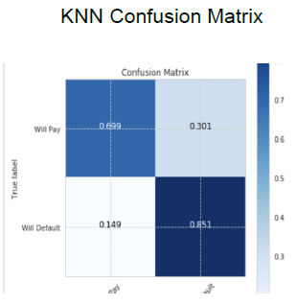
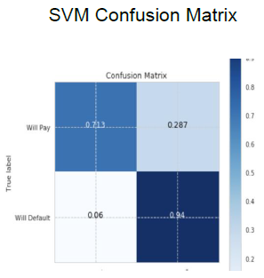
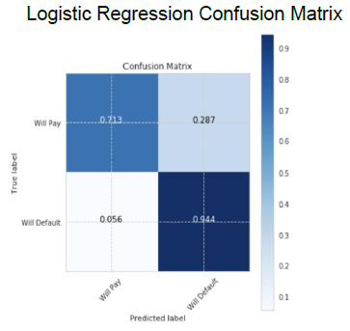
Confusion Matrix

Slide 7
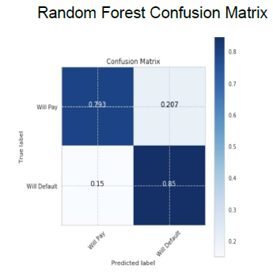
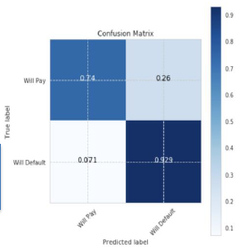
Confusion Matrix
Multi-Layer Perceptron Confusion Matrix

Slide 8
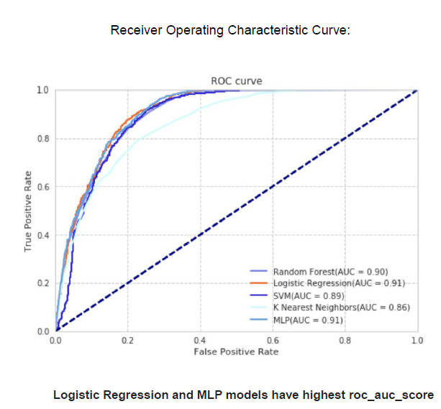
ROC Curve

Slide 9
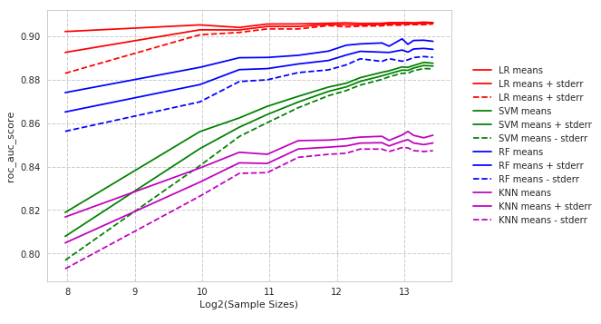
ROC Curve
Behavior of models with different sample sizes of dataset -- Plotted ROC_AUC_Score for different sample sizes similar to what we have done in one of the assignments.

Slide 10
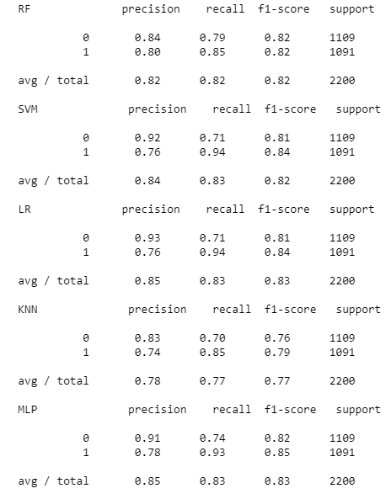
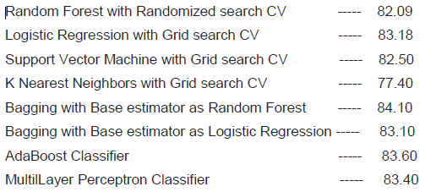
Model Accuracies

Slide 11
Limitations
We have not considered the effect of delayed payments which can be derived from various payment_dates fields of the dataset.
Cross-validation for support vector machine modeled here requires high computational time, hence not considered

Slide 12
Problem in Scope
We have used supervised learning algorithms like K-nearest neighbors, support vector machines and logistic regression.
We had 282,853 observations of data, which took a lot of time for training. By implementing learning curve for our data, We realized that models do not learn after 11000 observations. So, We downsized the date.
Data is pre-processed using scaling, filling null values etc.

Slide 13
Conclusion
From the dataset, We have the option of building 2 types of predictive models with target variables being,
1. if a person can be granted a loan or not
2. if a person who already borrowed the loan, will repay it or not.
After reviewing the date, building a model of type 2 seemed more appropriate. Hence the same has been done here.
The model with highest accuracy output is Bagging with Base Estimator as Random Forest.

